Slide 1


BATCH No. 9
Innovative and Creative Project
Dr. Mahalingam College of Engineering and Technology
Pollachi, Tamilnadu, India
Department of Information Technology
19ITPN6601 Innovative and Creative Project
(2022-2023 Even) - VI Semester
Thilak Raj G (20BIT026)
Sangeeth A (20BIT064)
Arungarai selvan E (20BIT072)
AI BASED CHATBOT ASSISTANT
Guided by
Submitted by
Mr.R.Govindaraj., AP / IT

Slide 2
OUTLINE
Abstract
Objective
Introduction
Existing System
Proposed System
Software Requirements
Modules Description
Result
Conclusion
Future Work
References

Slide 3
ABSTRACT
Chatbots, or conversational interfaces - a new way for individuals to interact with computer systems.
The technology at the core of the rise of the Chatbot is natural language processing (“NLP”).
Machine learning have greatly improved the accuracy and effectiveness of NLP, making Chatbot's a viable option for many organizations.
A Chatbot can be used anywhere a human is interacting with a computer system.

Slide 4
OBJECTIVE
The creation of a chatbot for personal use and help is the primary goal of this project.
Intelligent chatbots are mostly employed to provide customer service.
A sort of digital assistant called a chatbot is intended to increase business productivity by automating repetitive customer service duties.
These bots employ ML, AI, and NLP to comprehend and retain the conversation's context and the user's preferences.

Slide 5
INTRODUCTION
A novel approach for people to communicate with computers is through chat bots, or conversational interfaces as they are also known.
In the past, utilising a search engine or filling out a form were the only ways to get a software programme to answer a query.
With the help of a chat bot, users can ask inquiries as they would to a real person.
On computer chat platforms, chat bots are, however, currently being used very frequently.
Natural language processing ("NLP") technology is the driving force behind the growth of chat bots.

Slide 6
EXISTING SYSTEM
Existing systems are preliminary evolution of Chatbots with basic assistance to the app/websites.
Most of the systems are manually controlled and replied to the customers.
Natural Language Processing are not implemented in most of the organisational chatbots.
Most of the existing chatbots are not personalized and interactive for personal usage.
Similarly some assistance are good but as a personal console based chatbots are remarkably low.

Slide 7
PROPOSED SYSTEM
Our project is built on a chatbot that is driven by artificial intelligence.
Python is software that offers a user-friendly interface to make connections to the internet and use of valid and dependable web services more convenient and easy.
The web-based platform offers a sizable cognitive base that can aid in simulating human problem-solving.
Our methodology calls for the creation of an API for a chatbot that will use Javascript to operate and a Cascading Style Sheet to handle all styling.

Slide 8
SYSTEM REQUIREMENTS
HARDWARE SPECIFICATION
Disk space : 330MB for windows package extraction.
Graphics : No particular graphics card is necessary.
RAM : 4 Gigabytes per core is recommended.
SOFTWARE SPECIFICATION
Tool : Jupyter Notebook, VSCode.
Operating System : Windows or Linux.
Language : Python, AIML.

Slide 9
MODULES DESCRIPTION
MODULE 01
Simple Command-line based Chatbot.
MODULE 02
Instant Terminal based Chatbot.
MODULE 03
Chatbot embedded in website with separate user input
and response space.

Slide 10
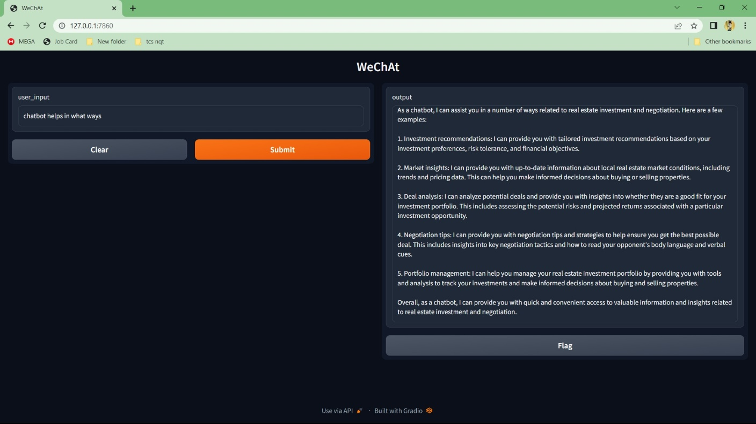
RESULTS

Slide 11
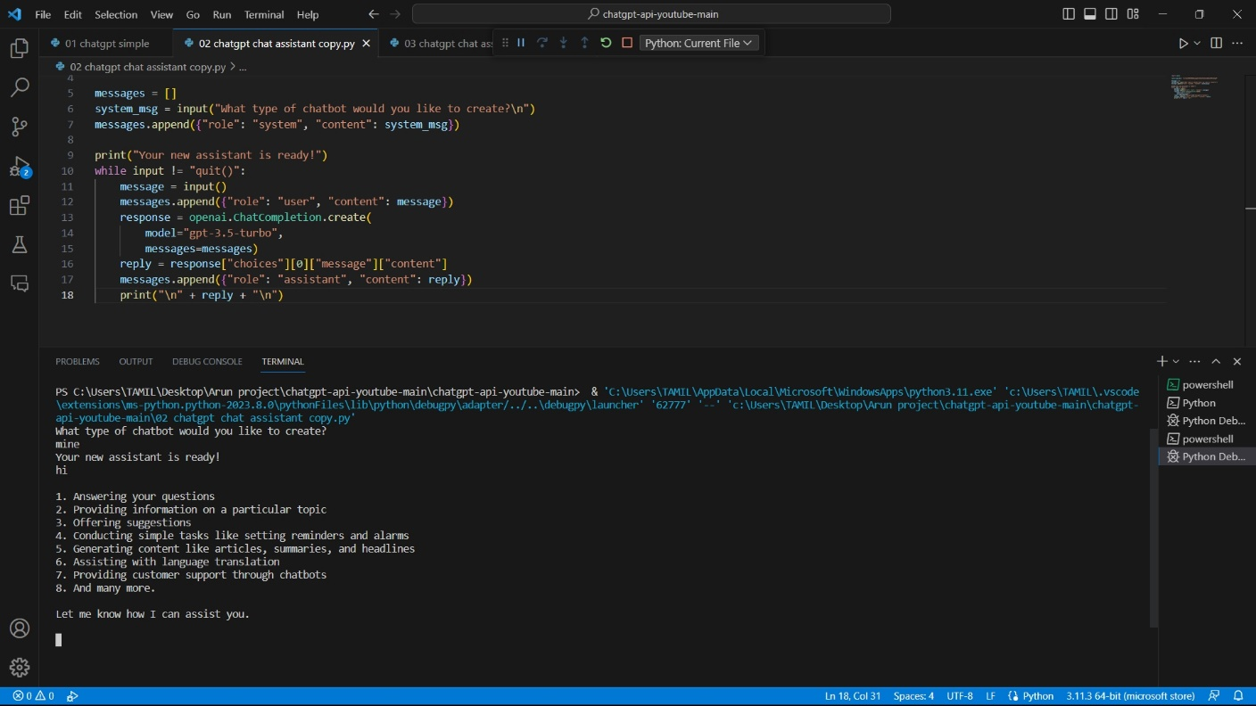
RESULTS

Slide 12
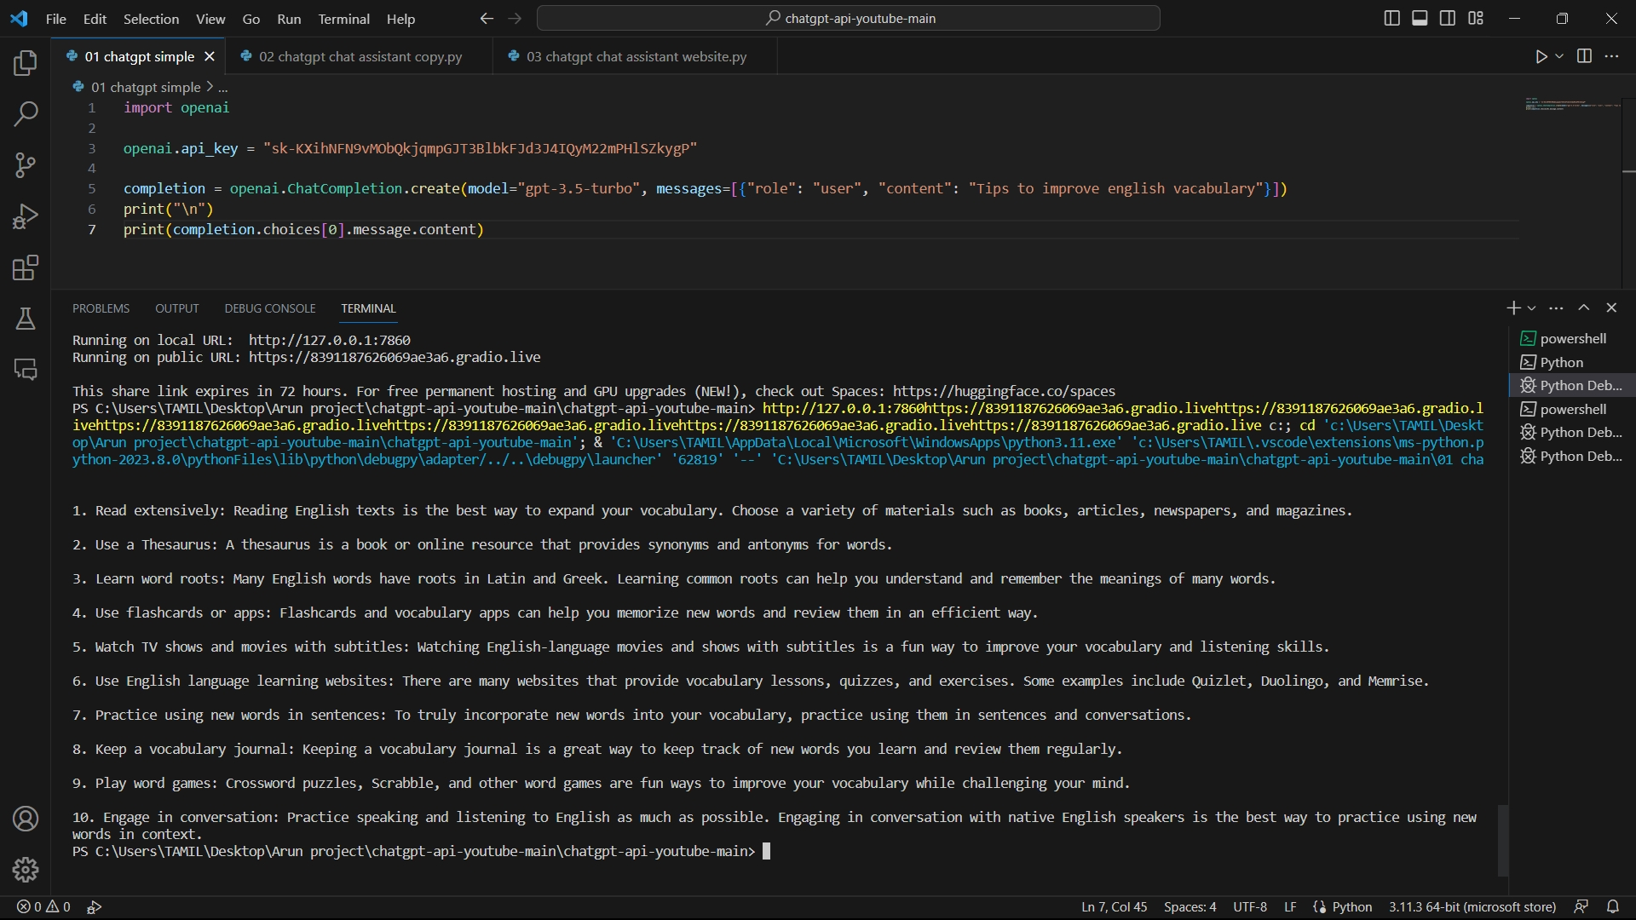
RESULTS

Slide 13
CONCLUSION
Chatbot’s can provide a human touch to various elements and make the discussion enjoyable.
And they give information and carry out tasks for the people they engage with with full attention.
Our research suggests that a chatbot might provide a viable substitute for a kind, supportive companion for freshmen at a new school.

Slide 14
FUTURE WORKS
Chatbots are the systematic automated response system trained with FAQ sets.
Thus our future and next modules will be the additional increment of some features like multilingual support and faster response system.
To develop more convincing UI design in the website module.
Also to create a unique Personal assistant chatbot app for personal usage and references.

Slide 15
REFERENCES
[1] A Platform for Human-Chat bot Interaction Using Python
[2] Bhaumik Kohli , Tanupriya Choudhury, Shilpi Sharma, Praveen Kumar.,” A Platform for Human- Chat bot Interaction Using Python”, IEEE , 2018.
[3] Tussanai Parthornratt, Pasd Putthapipat, Dollachart Kitsawat , Prapap Koronjaruwat,” A Smart Home Automation via Facebook Chat bot and Raspberry Pi”, IEEE, 2018.
[4] Parth Thosani ,Manas Sinkar ,Jaydeep Vaghasiya, Radha Shankarmani,” A Self Learning Chat-Bot from User Interactions and Preferences”, IEEE , 2020.
[5] Prakhar Srivastava, Nishant Singh,” Automatized Medical Chat bot (Medibot)”, IEEE, 2020.

Slide 16
QUERIES?☺

Slide 17

THANK YOU☺

